Slide 1
SAFETY DATA ANALYTICS GREAT STEP-2019
IIT KHARAGPUR

Slide 2
Project analysis slide 3
Project Analysis
INTRODUCTION
DESCRIPTIVE
STATISTICS
RELATION BETWEEN PM10 AND PM2.5
RELATIONAL ANALYSIS OF PM10 WITH WIND SPEED AND AIR TEMPERATURE
REGRESSIONAL ANALYSIS OF PM10 AND PM2.5

Slide 3
Introduction
CONTENT OF THE REPORT:
In this report we aim to study various interesting patterns and relationship between various elements of air-pollutant and natural phenomena namely Atmospheric Temperature and Wind Speed from the data that has been collected from Central Pollution Control Board of India. The mentioned fields(variables) in data are PM2.5, PM10 where these 2 are the key pollutants, Atmospheric Temperature and Wind Speed.
TASKS TO BE ACCOMLISHED:
Here we have primarily 2 tasks at our hand and through this we would try to answer important questions:
Present the Stakeholders with the descriptive statistics of all the variables given to us and to draw inference from them.
Checking the trend which these 2 key pollutants follow w.r.t Wind Speed and Temperature and validate them with Statistical Hypothesis Testing i.e. present the Relational Analysis.

Slide 4
Q1.Descriptive Statistics and Primary Observations
 | PM2.5 | PM10 | WIND SPEED | AIR TEMPERATURE
MEAN | 165.90 | 367.96 | 2.76 | 25.34
MEDIAN | 136.68 | 298.92 | 2.67 | 24.71
MODE (frequency) | 200.64,116.1, 0.00 (2) | 252.25,136.46, 178.28,438.92 (2) | 2.18,2.62 3.01,2.81 (9) | 22.99,23.36, 30.65,19.07 (3)
STANDARD DEVIATION | 97.24 | 203.41 | 0.77 | 5.79
CO-EFFICIENT OF VARIATION | 58.61 | 55.28 | 27.89 | 22.84
Interesting Fact About Mode: All the variables have more than 1 mode . Out of 500 observations , mode value has frequency of order of 10,hence mode is not at all an important statistical measure.

Slide 5
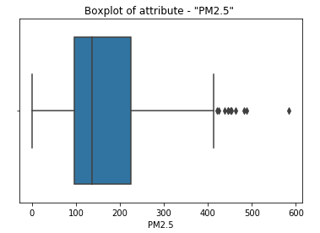
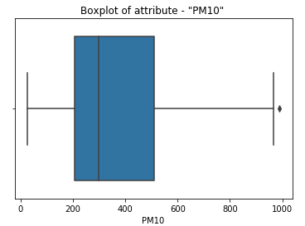
BOXPLOTS

Slide 6
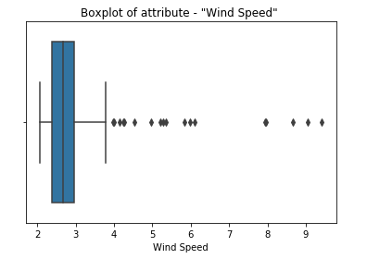
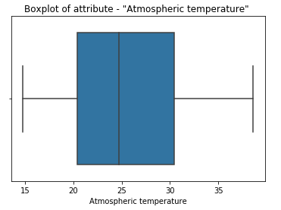
BOXPLOTS

Slide 7
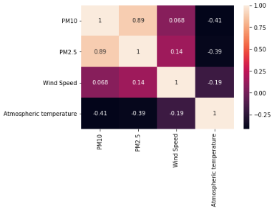
CORRELATION ANALYSIS
DESCRIPTION:
Here the numbers in the boxes represents the value of Karl Pearson’s Correlation Coefficient between the 2 corresponding attributes at the periphery.
OBSERVATIONS:
There is a high degree of correlation between PM2.5 and PM10 i.e. 0.89 ; signifying that they are constituted mostly of the same thing.
No other correlation value seems to be sufficiently great. But it seems on average concentration of PM10, PM2.5 decreases with increasing Temperature and vice-versa.

Slide 8
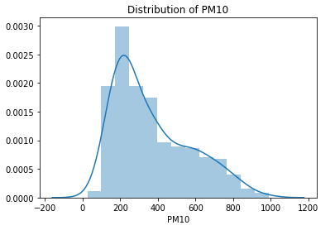
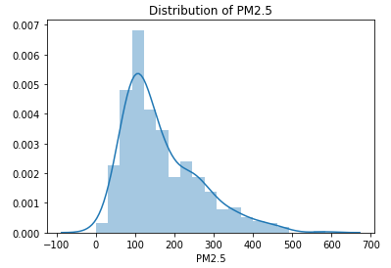
Q2.Relation between PM2.5 and PM10
We thus observe how strikingly similarly PM2.5 and PM10 are distributed in the entire dataset. This furthermore strengthen our idea of the similarity between PM2.5 and PM10.

Slide 9
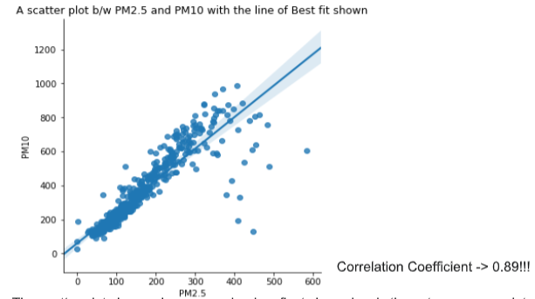
SCATTER PLOT
CONCLUSION:
Thus we conclude that PM2.5 and PM10 follows similar trend over the entire distribution.
Through the Scatter plots and distribution-plots we have shown the striking similarity between them.

Slide 10

Q3. Relational analysis of PM10 with Wind Speed and Air Temperature
Here we are to use T-test as the method of Statistical Hypothesis Testing that would help us to decide between if at all PM10 is related with any of the above mentioned attributes.
H_0: PM10 and Wind-Speed are not Correlated
H_a: PM10 is correlated with Wind Speed
H_0 is the Null Hypothesis and H_a is the Alternative Hypothesis.
The t statistic is . Here the degrees of freedom is n-2 where n is the number of data points and r is the modulus of Correlation Coefficient.
Now according to the theory of Statistical Hypothesis testing as this is a one-tailed test we get that if t_calculated>t_cutoff then our H_0 i.e Null Hypothesis would be essentially rejected i.e worth taking the risk of incurring type-1 error. And else: we fail to reject H_0 and eventually accept it.
HYPOTHESIS
T-TEST PROCEDURE
STATISTIC
ACCEPTION

Slide 11
Relational analysis of PM10 with Wind Speed
 | WIND SPEED
CORRELATION COEFFICIENT | 0.068
T-VALUE | 1.521
NULL HYPOTHESIS | ACCEPT THE NULL HYPOTHESIS
CONCLUSION
Thus we accept that PM10 and Wind-Speed are not
having any kind of relation and this small correlation whatsoever have crept into our data is by
chance!.
The cutoff t-value at 5% level of significance and 498 (500-2) degrees of freedom is 1.65(approx.).

Slide 12
Relational analysis of PM10 with Air Temperature
 | AIR TEMPERATURE
CORRELATION COEFFICIENT | -0.41
T-VALUE | 10.031
NULL HYPOTHESIS | REJECT THE NULL HYPOTHESIS
CONCLUSION
Here since the t value is greater than t_cutoff we reject the hypothesis and conclude that PM10 and Air Temperature are significantly correlated to one another .
The cutoff t-value at 5% level of significance and 498 (500-2) degrees of freedom is 1.65(approx.).

Slide 13
KEY TAKE-AWAYS FOR WIND SPEED AND AIR TEMPERATURE
PM10 & WIND SPEED are not correlated
PM10 & AIR TEMPERATURE are correlated

Slide 14
Q4.Regression Analysis of PM10 and PM2.5
Now we are to find the coefficients and determine the best linear model that would be able to predict the concentration of PM10 and PM2.5 . For this purpose we only consider Linear Models and decide among them which is the best with Statistical Hypothesis Testing. Here we use F-Statistic.
Modelling the Concentration of PM-10
Here we would consider models which are Linear.
PM10 = (Air Temperature)*c1 + (Wind Speed)*c2 +d + error
PM10= (Air Temperature)*c1 + d + error
PM10=(Wind Speed)*c1 + d + error
Every time we would determine the coefficients through least squares and would evaluate the degrees of freedom and also the sum of squared residue of all the data belonging to the Testing data.

Slide 15
Q4a. Analysis of PM10
Coefficients associated > | Air Temperature | Wind Speed | Intercept
Model a | -14.60855586 | -3.05967196 | 746.7049963597715
Model b | -14.53006377 | 0.0 | 736.2413680160535
Model c | 0.0 | 17.66596888 | 319.0380659610652
The models are:-
PM10 = -14.60* Air Temperature -3.05* Wind Speed+ 746.70
PM10=-14.53* Air Temperature +736.24
PM10=17.66* Wind Speed+319.03

Slide 16
Here we first determine the Null Hypothesis and Alternative Hypothesis.
H_0 : The simpler model (model b) performs at-least as good as the complex model.
H_a : The complex model (model a) performs actually better than the simple one.
HYPOTHESIS
 | Mean Squared Error | Number of predictors less than that of Full mdl | F_Statistic
Model a | 34216.547571975934 | 0 | --
Model b | 34222.01074287675 | 1 | 0.07935329922
Model c | 41104.01069493179 | 1 | 100.01413372
F_Cutoff=3.87 (approx.)
Since F- value of model b is smaller than F_cutoff we fail to reject that the Simpler model performs as good as Model a now as complexity of Model a > Model b, we conclude Model b is better than Model a.
Similarly F-value of model c > cut off value thus we conclude Model c performs worse than Model a.
Thus Model b > Model a > Model c
CONCLUSION

Slide 17
Q4b. Analysis of PM2.5
Coefficients associated > | Air Temperature | Wind Speed | Intercept
Model a | -6.39070774 | 8.7383198 | 303.67720896390654
Model b | -6.6148785 | 0.0 | 333.5609782111226
Model c | 0.0 | 17.805028 | 116.58860225228784
The models are:-
PM2.5 = -6.39* Air Temperature +8.73* Wind Speed+ 303.67
PM2.5=-6.61* Air Temperature +333.56
PM2.5=17.80* Wind Speed+116.58

Slide 18
Here we first determine the Null Hypothesis and Alternative Hypothesis.
H_0 : The simpler model (model b) performs at-least as good as the complex model.
H_a : The complex model (model a) performs actually better than the simple one.
HYPOTHESIS
 | Mean Squared Error | Number of predictors less than that of Full mdl | F_Statistic
Model a | 7928.542681407251 | 0 | --
Model b | 7973.1032705220805 | 1 | 2.793276574
Model c | 9246.625287754807 | 1 | 82.68
F_Cutoff=3.87 (approx.)
Similarly thus we accept that Model b is better than Model a as F- value of Model b is less than Model a. And Model c is worse off than Model a and thus according to Model Performance :
Model b > Model a > Model c.
CONCLUSION

Slide 19
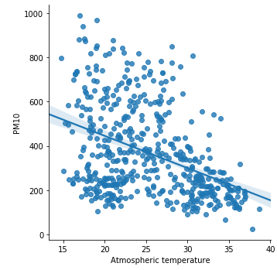
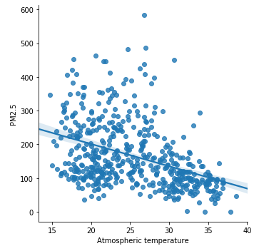
FINAL MODELS FOR PM10 AND PM2.5
PM10=-14.53* Air Temperature +736.24
PM2.5=-6.61* Air Temperature +333.56

Slide 20
APPENDIX
The t statistic is :
Here r is the Karl Pearson’s Correlation Coefficient.
N= number of data points
t here follows t_(n-2) i.e. has (n-2) degrees of freedom.
Com refers to Complex Model
Red refers to Reduced Model
F= (RSS_red – RSS_com)/p
RSS_com/(n-k)
K= Number of coeff. Including the intercept.
P=No. of extra predictors in Com
N= number of data points
This follows F_(p,n-k)

Slide 21
Thank You

